Slide 1
Recommender System
Session 13-14

Slide 2
Learning Outcome
LO 1: Explain the fundamental of machine learning concept
LO 2: Interpret the distribution of dataset using regression method
• LO 3: Experiment classification and clustering algorithm from given dataset

Slide 3
Outline
Introduction
Content Based Recommendation
Collaborative Recommendation

Slide 4
Introduction

Slide 5


Introduction
Recommender system: The Task
Customer A:
Buy Beethoven CD
Buy Mozart CD
Customer B:
Does search Mozart
The System recommend Beethoven based on the data collected from Customer A

Slide 6
Introduction
Recommender Systems (RSs) are software tools and techniques providing suggestions for items to be of use to a user
The suggestions relate to various decision-making processes, such as what items to buy, what music to listen to, or what online news to read.
RSs try to predict what the most suitable products or services are, based on the user’s preferences and constraints.

Slide 7
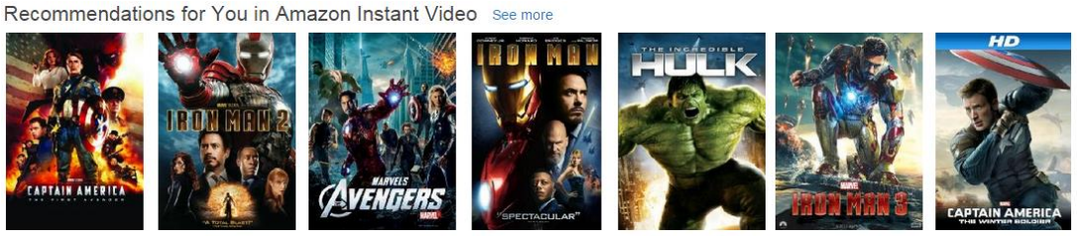
Introduction
Why Recommender System?
To Help people discover new content

Slide 8
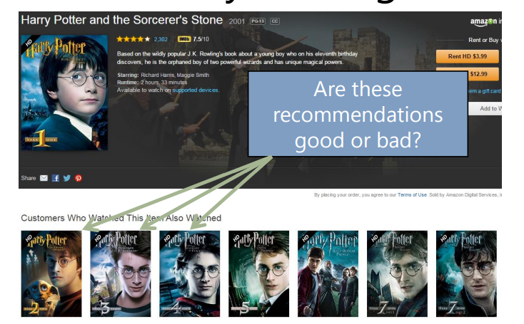
Introduction
Why Recommender System?
To help us find the content we were already looking for

Slide 9
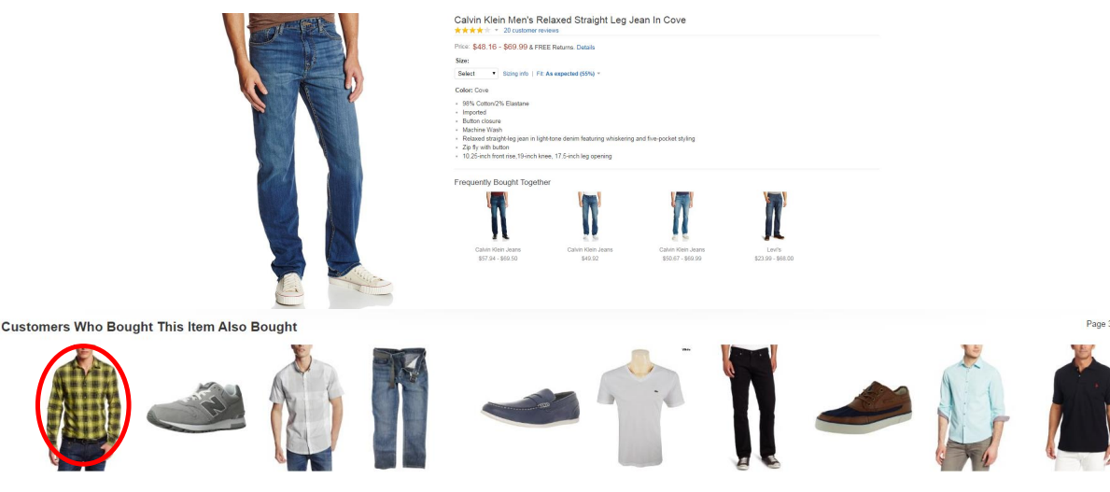
Introduction
Why Recommender System?
To discover which things, go together

Slide 10
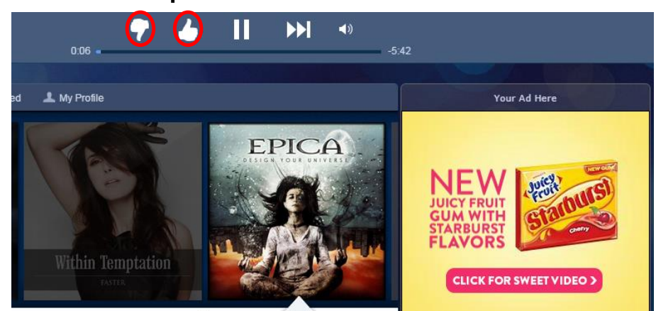
Introduction
Why Recommender System?
To personalize user experiences in response to user feedback

Slide 11
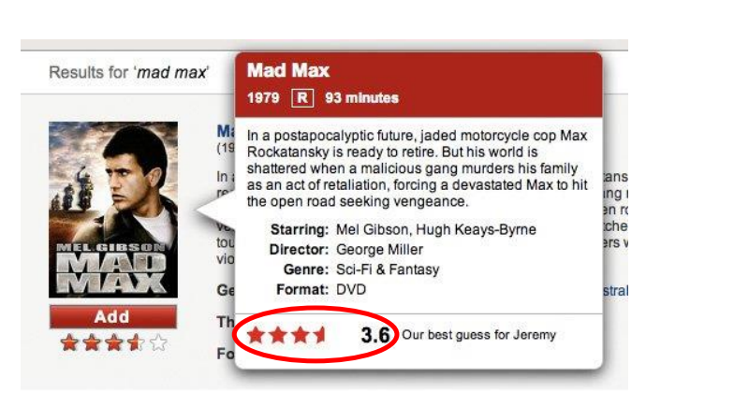
Introduction
Why Recommender System?
To identify thing that we like

Slide 12
Introduction
Why Recommender System?
To model people’s preferences, opinions, and behavior

Slide 13
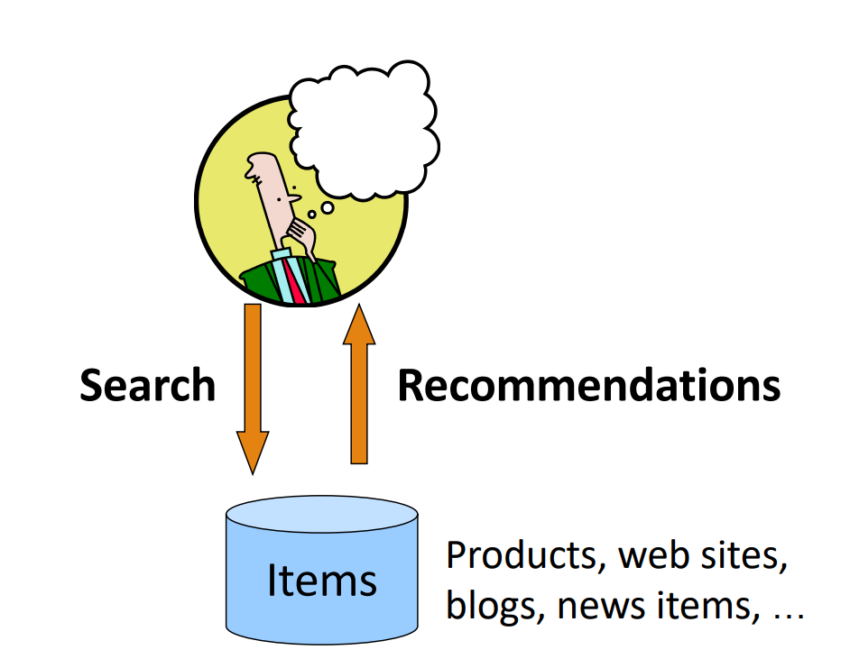
Introduction

Slide 14
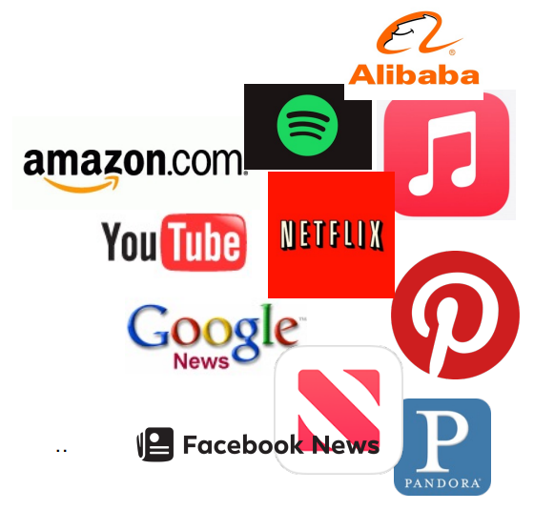
Introduction
Some companies that used recommender System:

Slide 15
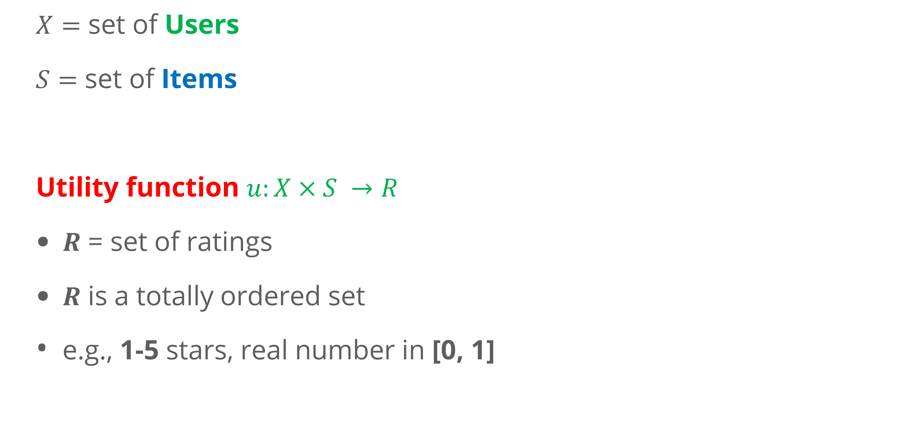
Introduction
Formal Model
$X=$ set of Users
$S=$ set of Items
Utility function $u:X×S →R$
$R$ = set of ratings
$R$ is a totally ordered set
e.g., 1-5 stars, real number in [0, 1]

Slide 16
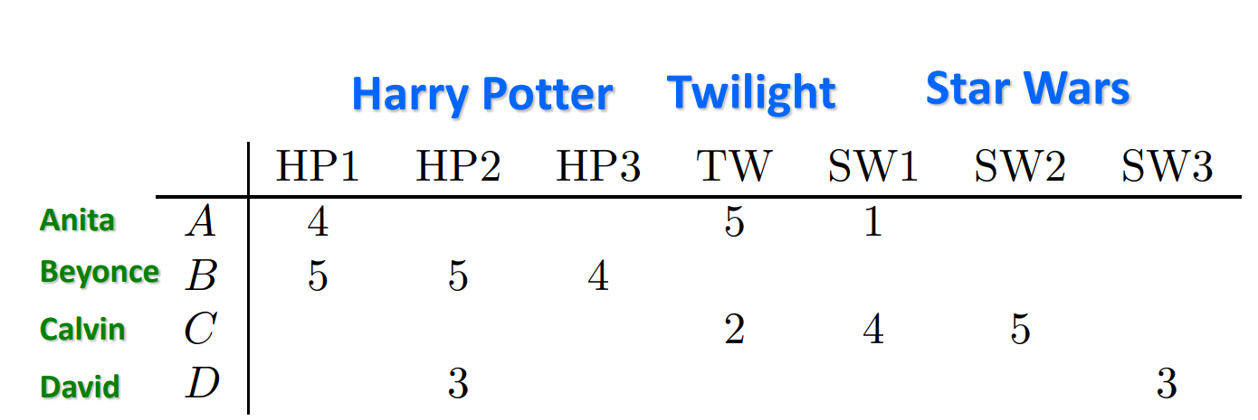
Introduction
Utility Matrix

Slide 17
Introduction
Key Problems
Gathering “known” ratings for matrix
How to collect the data in the utility matrix
Extrapolate unknown ratings from known ones
Mainly interested in high unknown ratings
We are not interested in knowing what you don’t like but what you like
Evaluating extrapolation methods
How to measure performance of recommendation methods

Slide 18
Introduction
Gatheting Ratings
Explicit
Ask people to rate items
Doesn’t work well in practice – people can't be bothered
Crowdsourcing: Pay people to label items
Implicit
Learn ratings from user actions
E.g: purchase (or watch video, or read article) implies high rating

Slide 19
Introduction
Extrapolating Utilities
Key problem: Utility matrix U is sparse
Most people have not rated most items
The “Cold Start” problem:
New items have no ratings
New users have no history

Slide 20
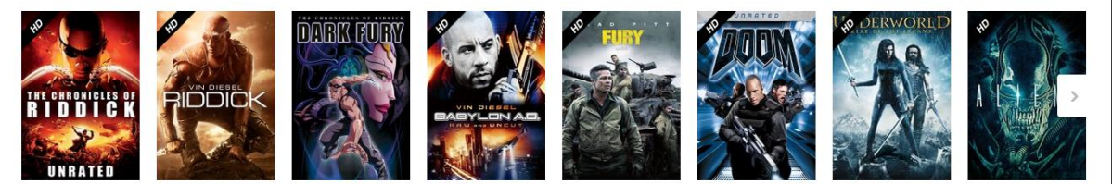
Introduction
Recommending thing to people
Suppose we want to build a movie recommender
e.g. which of these films will I rate highest?

Slide 21
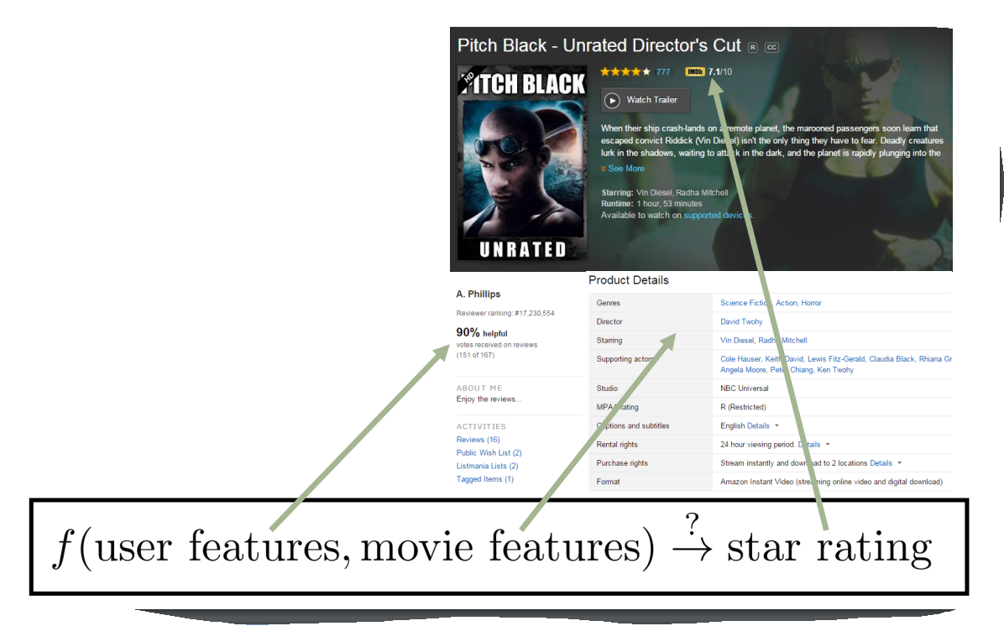
Introduction
Recommending thing to people

Slide 22
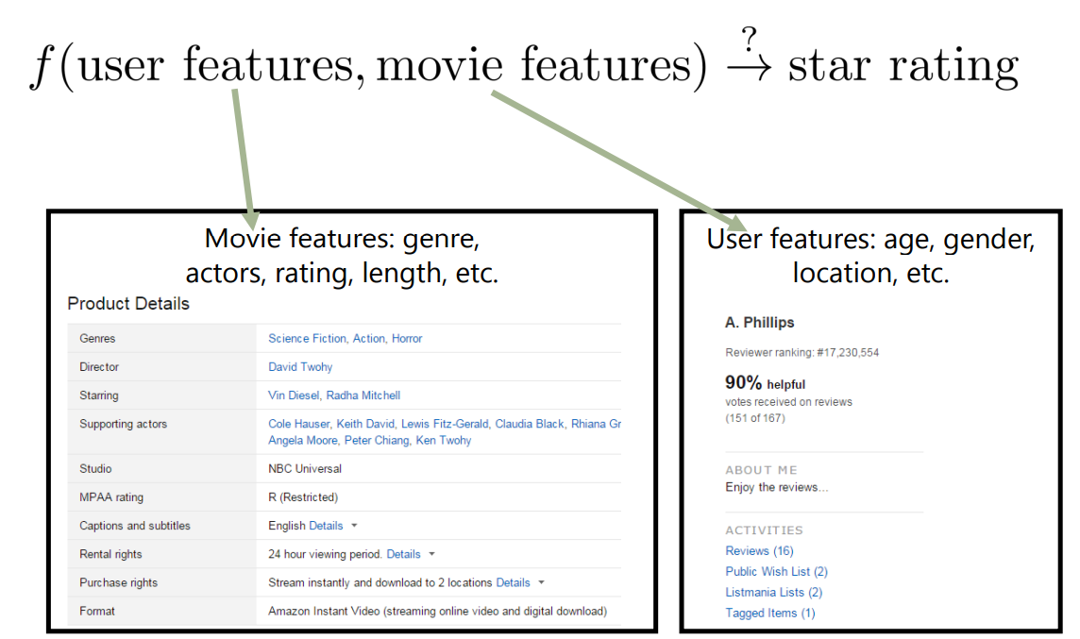
Introduction
Recommending thing to people

Slide 23
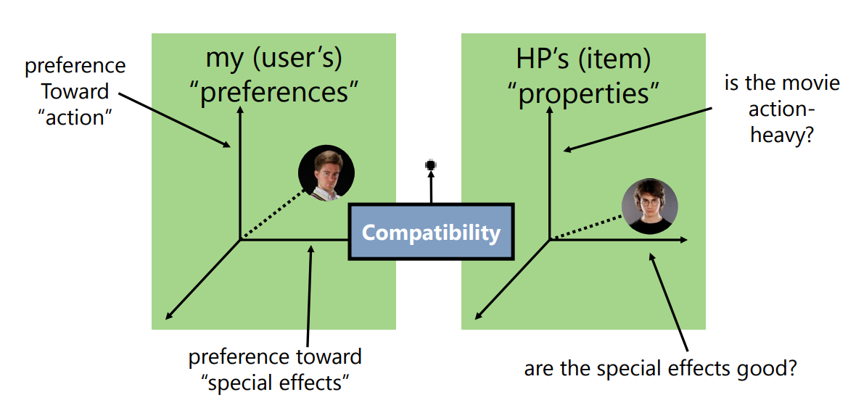
Introduction
Recommending thing to people
Recommender Systems go beyond the methods we’ve seen so far by trying to model the relationships between people and the items they’re evaluating

Slide 24
Introduction
Three approach to recommender systems:
Content-based
Collaborative Based
Latent Factor
This Lecturer

Slide 25
Content Based Recommendations

Slide 26
Content Based Recommendations
Main Idea: Recommend items to customer x similar to previous items rated highly by x
Movie Recommendation:
Recommend movies with same actor(s), director, genre,…
Websites, blogs, news
Recommend other sites with similar types or words

Slide 27
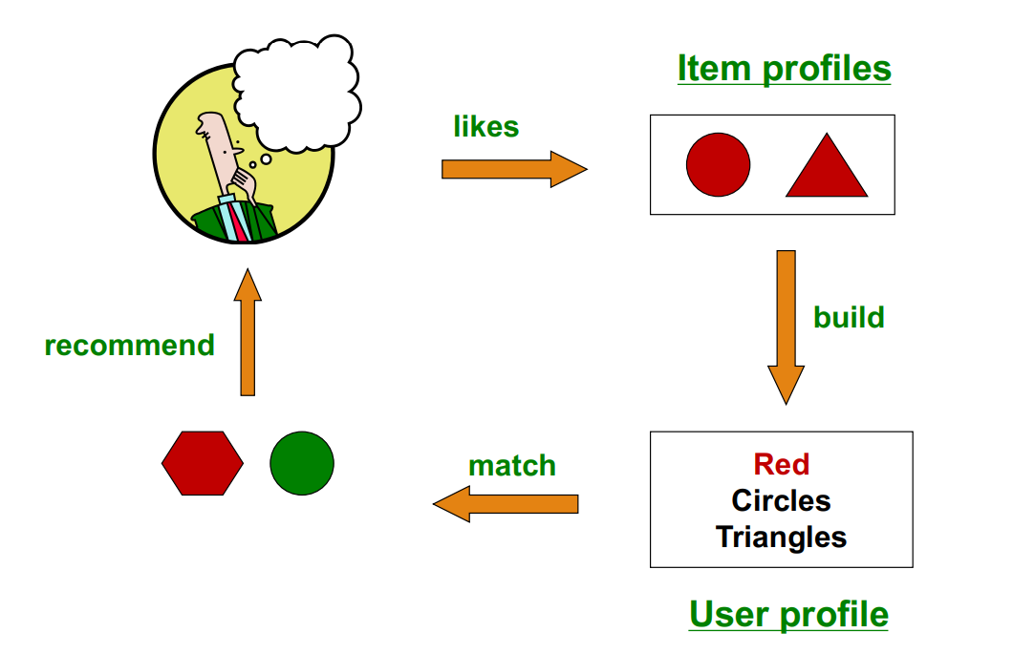
Content Based Recommendations
Plan of Action

Slide 28
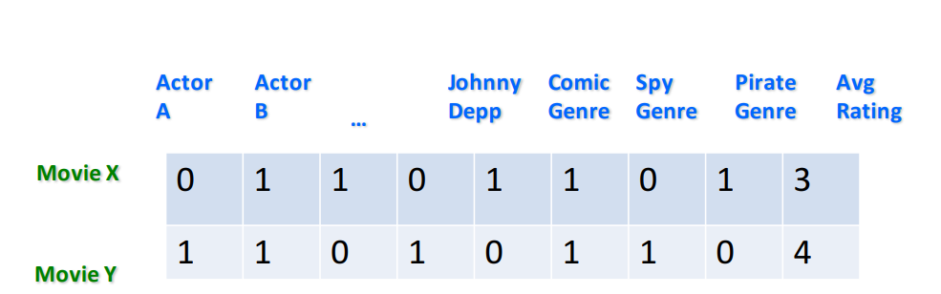
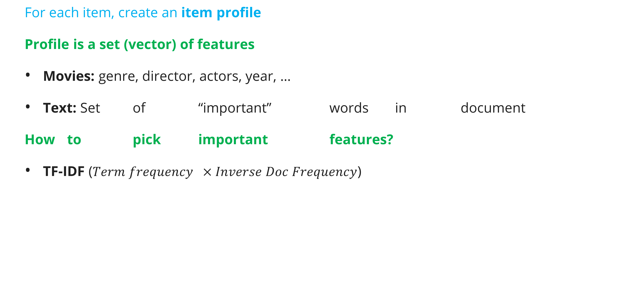
Content Based Recommendations
Item Profiles
For each item, create an item profile
Profile is a set (vector) of features
Movies: genre, director, actors, year, …
Text: Set of “important” words in document
How to pick important features?
TF-IDF ($Term frequency ×Inverse Doc Frequency$)

Slide 29
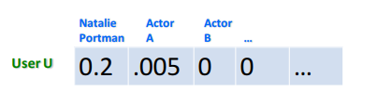
Content Based Recommendations
Item Profiles
Want a vector with the same components/ dimensions as items
Could be 1s representing user purchases
Or arbitrary numbers of rating
User profile is aggregate of items:
Average (weighted?) of rated item profiles

Slide 30
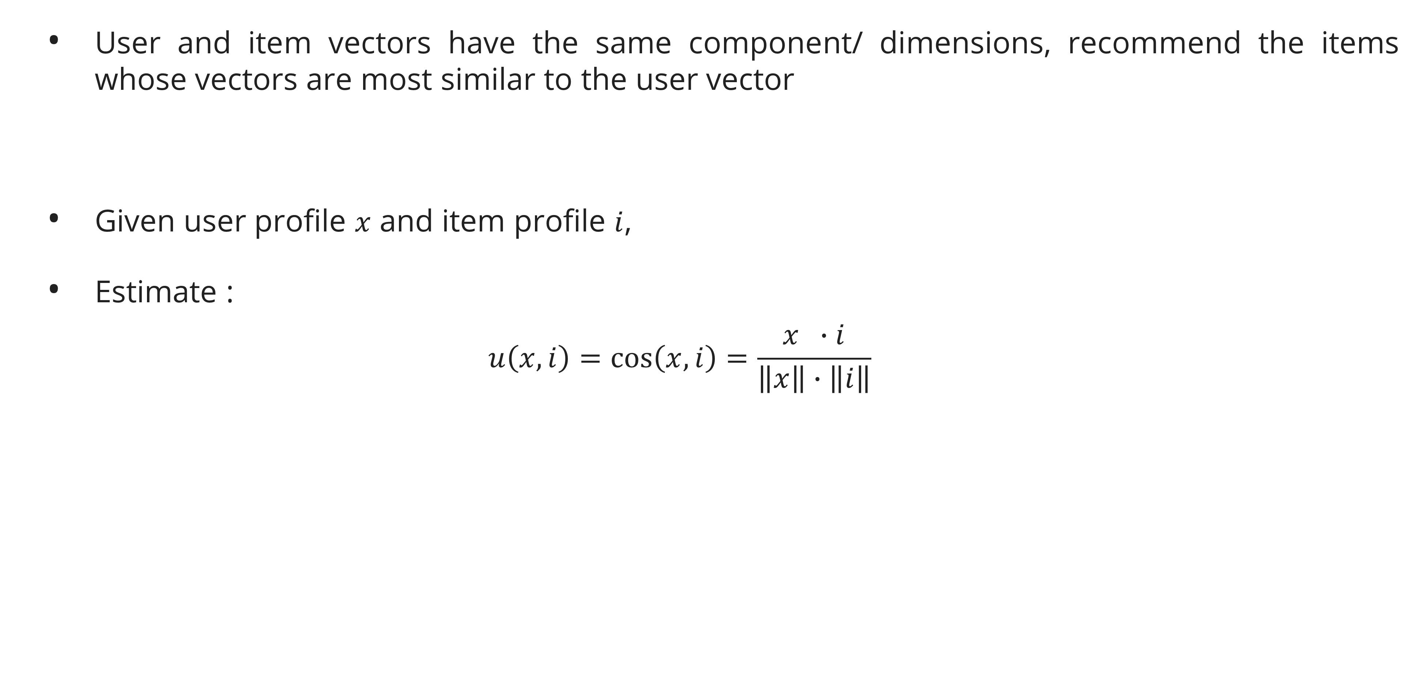
Content Based Recommendations
Prediction
User and item vectors have the same component/ dimensions, recommend the items whose vectors are most similar to the user vector
Given user profile $x$ and item profile $i$,
Estimate :
$$u\left(x,i\right)=\cos\left(x,i\right)=\frac{x ∙i}{\left\|\left.x\right\|\right.∙\left\|\left.i\right\|\right.}$$

Slide 31
Content Based Recommendations
Pros and Cons
Pros
No need for data on other users
Able to recommend to user with unique tastes
Able to recommend new and unpopular items
Able to provide explanation
Cons
Finding the appropriate features is hard
Recommendation for new users
Overspecialization

Slide 32
Collaborative FIltering

Slide 33
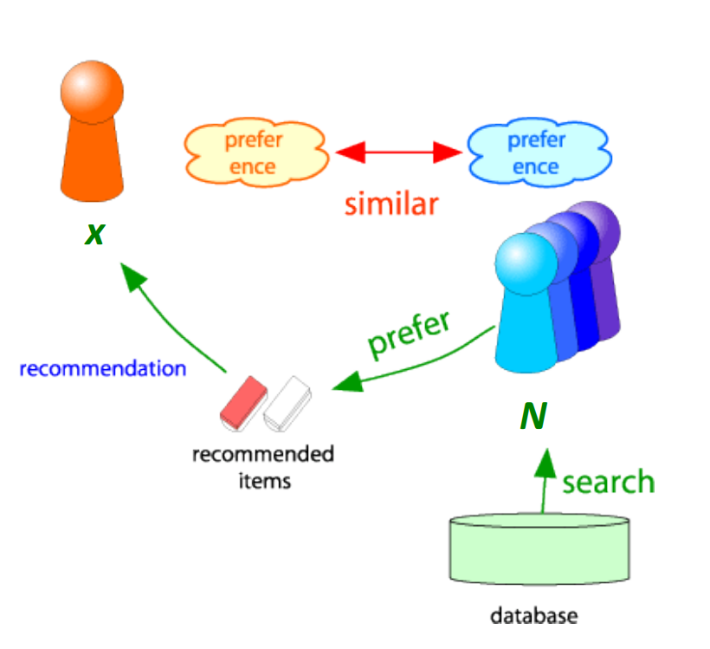
Collaborative Filtering
Consider user x
Find set N of other users whose ratings are “similar” to x’s ratings
Estimate x’s ratings based on users in N

Slide 34
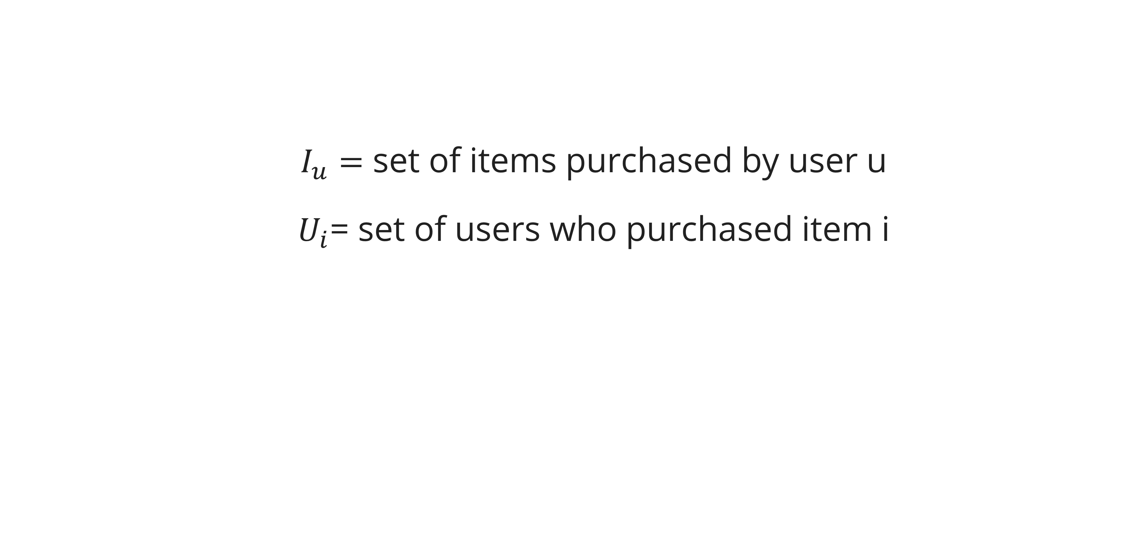
Collaborative Filtering
Definitions
$I_{u}=$ set of items purchased by user u
$U_{i}$= set of users who purchased item i

Slide 35
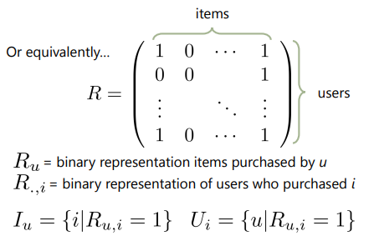
Collaborative Filtering
Definitions

Slide 36
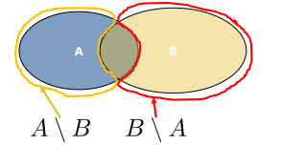
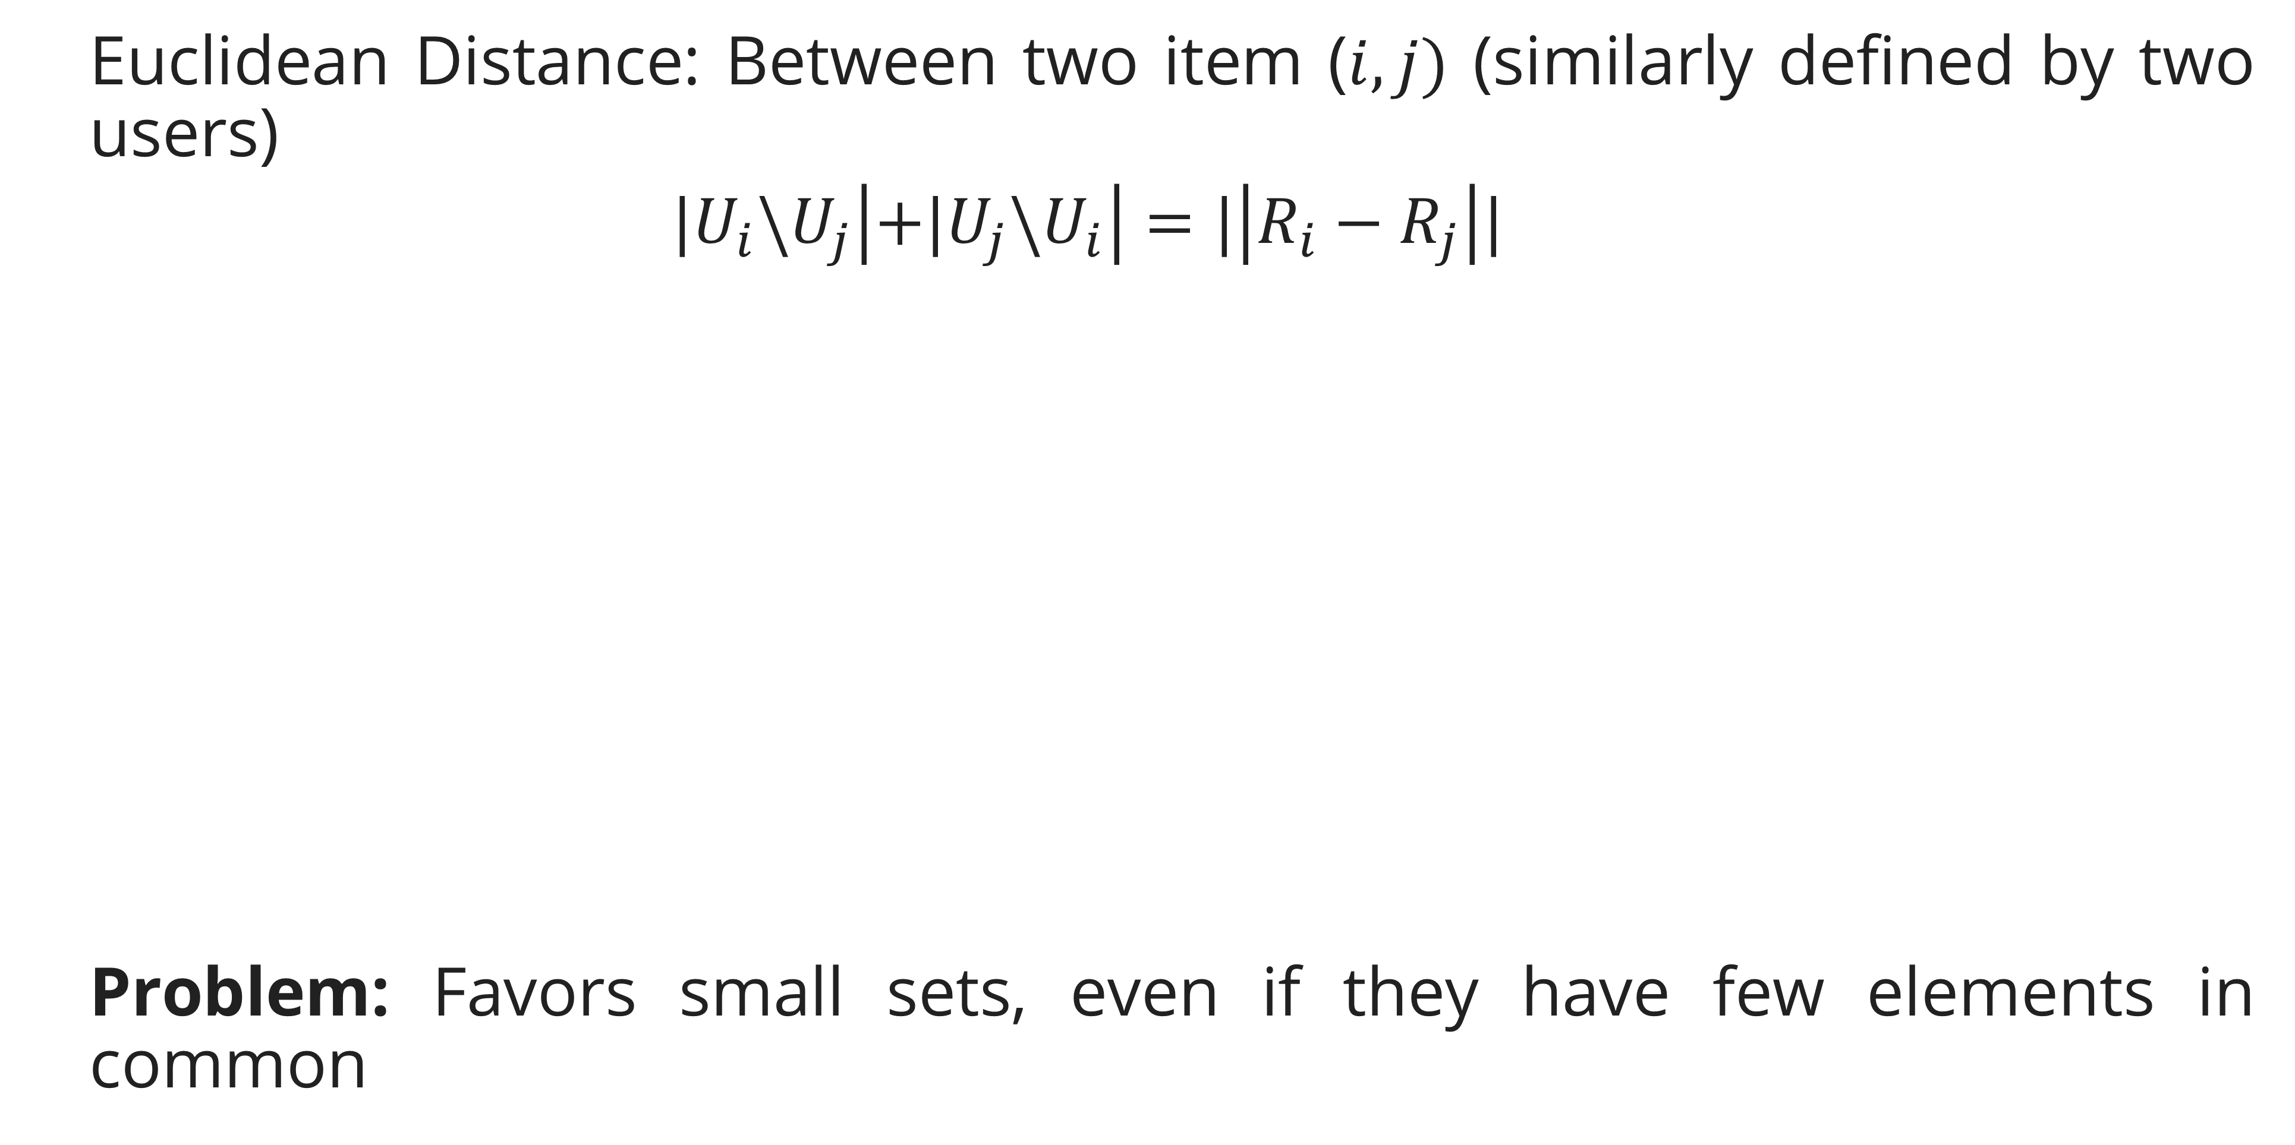
Collaborative Filtering
Euclidean Distance
Euclidean Distance: Between two item ($i, j)$ (similarly defined by two users)
$$|U_{i}\backslash U_{j}\left|+|U_{j}\backslash U_{i}\right|=|\left|R_{i}−R_{j}\right||$$
Problem: Favors small sets, even if they have few elements in common

Slide 37
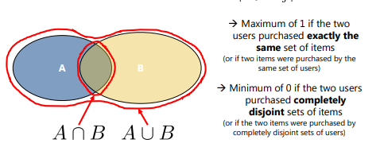
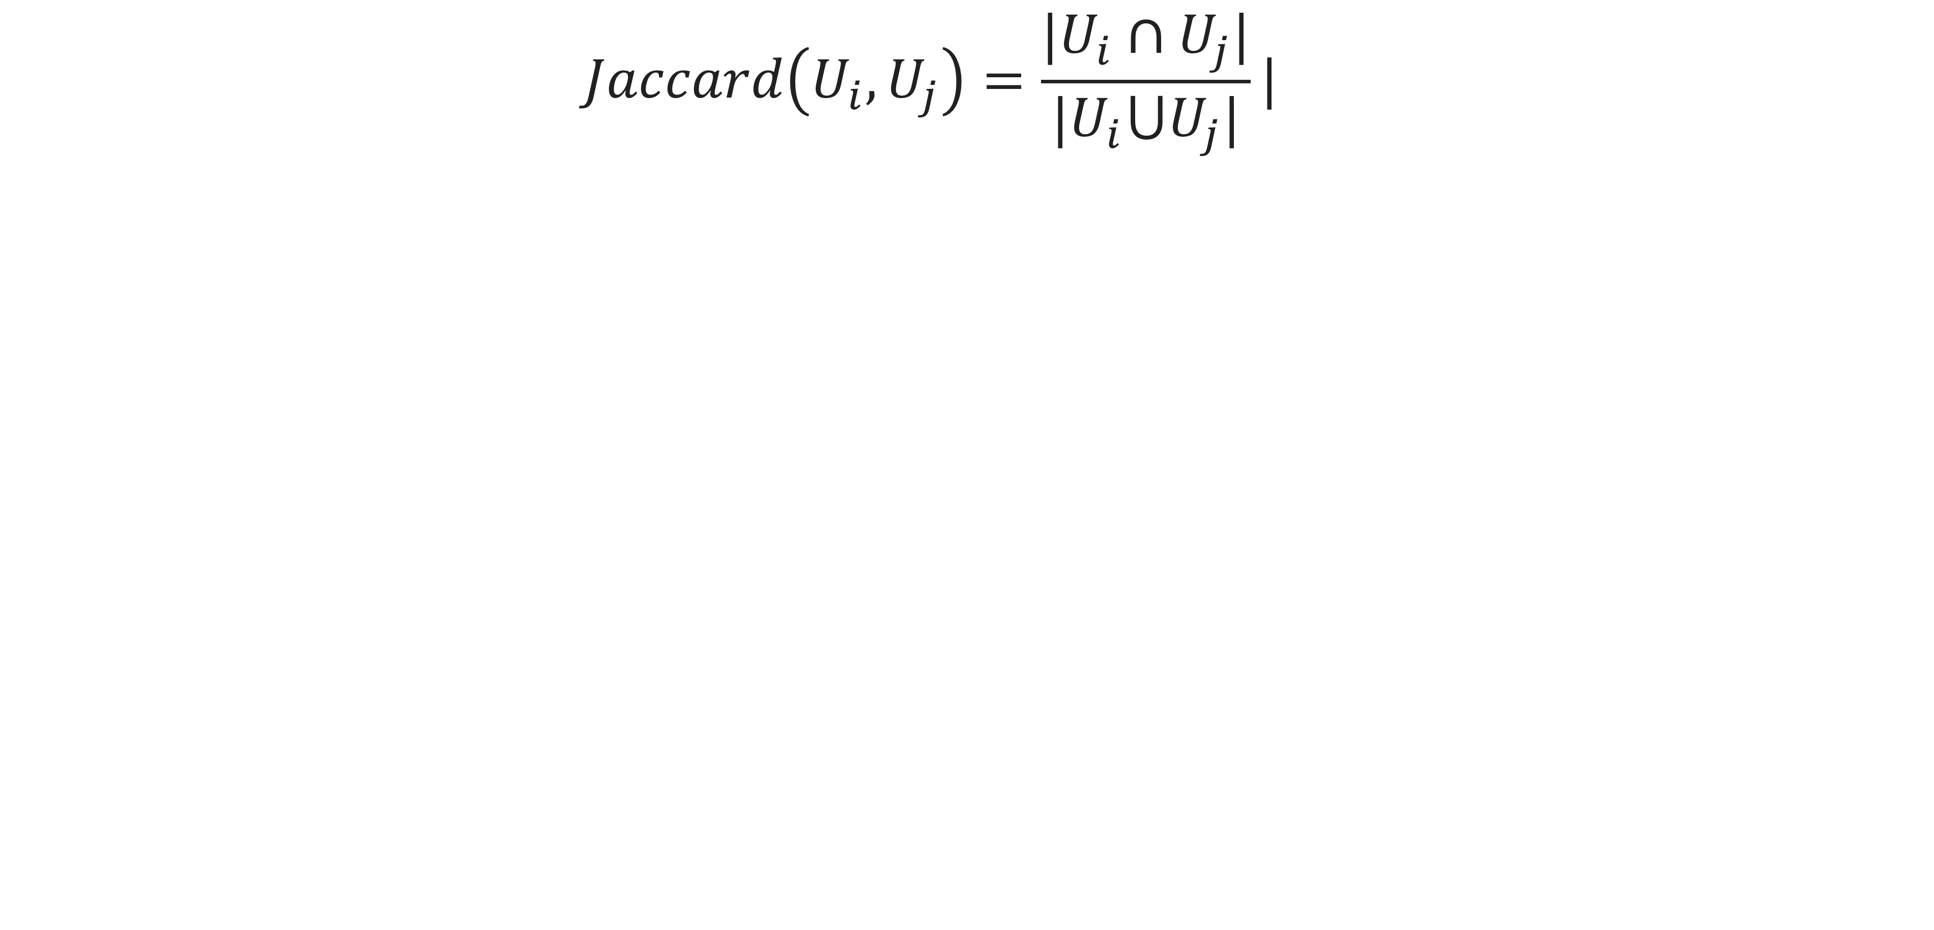
Collaborative Filtering
Jaccard Similarity
$$Jaccard\left(U_{i},U_{j}\right)=\frac{|U_{i}∩U_{j}|}{|U_{i}⋃U_{j}|}|$$

Slide 38
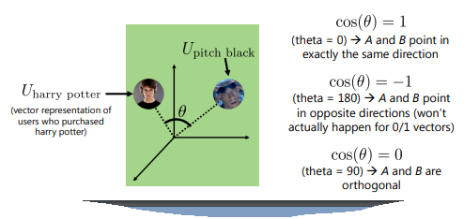
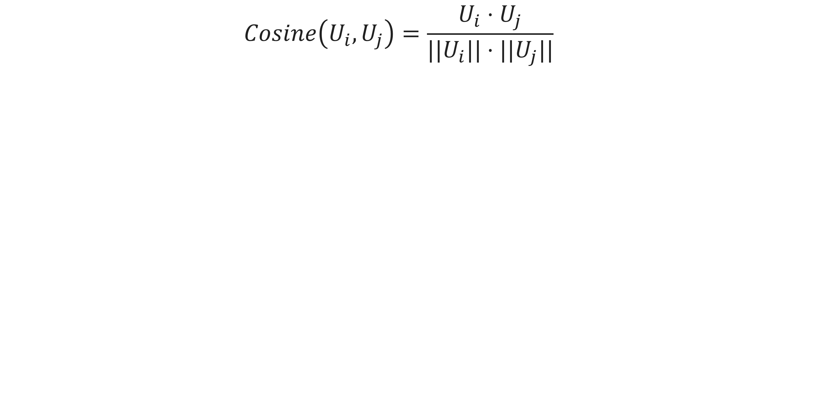
Collaborative Filtering
Cosine Similarity
$$Cosine\left(U_{i},U_{j}\right)=\frac{U_{i}⋅U_{j}}{||U_{i}||⋅||U_{j}||}$$

Slide 39
Exercise

Slide 40
Exercise
As a data scientist in a tech company, you are tasked with developing a music recommendation system similar to Spotify’s (https://www.kaggle.com/datasets/bricevergnou/spotify-recommendation) . This system aims to enhance user experience by suggesting songs or artists based on their listening history, preferences, and behavior.
Choose an appropriate model for your recommendation system. This could be a collaborative filtering model, a content-based model, or even a hybrid model.
Develop the model to analyze user behavior and predict songs or artists they might like.
Determine how you will measure the success of your recommendation system.
Test the model with a set of users or simulated data to evaluate its performance.

Slide 41
References

Slide 42
References
Jurafsky, D. (2023). Recommender systems and Collaborative Filtering. CS 124: From Languages to Information. https://web.stanford.edu/class/cs124/lec/collaborativefiltering21.pdf
Leskovec, J., Rajaraman, A., & Ullman, J. D. (2020). Mining of massive datasets (3e ed). Cambridge university press.
McAuley, J. (2015). Recommender Systems. CSE 255: Dahta Mining and Predictive Analytics. https://cseweb.ucsd.edu/classes/wi15/cse255-a/slides/lecture1_outline.pdf
Ricci, F., Rokach, L., Shapira, B., & Kantor, P. B. (Eds.). (2011). Recommender Systems Handbook. Springer US. https://doi.org/10.1007/978-0-387-85820-3

